Slide 1
Enhancing entrepreneurial mindset and self-empowerment in kids - EMPOW4KIDS
ERASMUS+ KA220-SCH - Cooperation partnerships in school education
2021-1-CZ01-KA220-SCH-000032484

Slide 2
WHAT IS A PITCH?
A pitch is a special way to tell a story and show your business idea to others (like investors or potential partners). It helps you get support and turn your dreams into reality.
In your pitch, you'll talk about things like what problem your idea solves, how your idea is different from other similar things out there, and how it can make people's lives better or easier.
You might also talk about how you're going to make money from your idea and how it can grow and become even more amazing over time.
As a summary you will have to be able to answer the following questions about your business idea: WHAT?; WHO?; HOW? and HOW MUCH?

Slide 3
WHAT?

Slide 4
WHAT?
Value proposal
In this part of the Pitch you will explain your value proposal.
The Value Proposal is the unique offer that your business is providing to the customers. This offer can be a physical product or service. Important and crucial is that the product/service should to be beneficial to the customers by solving some of their problems.
Before designing your idea (your product or service) the following should be considered from the perspective of potential customers:
Needs – needs that the customers have. Consider both needs that the customers are aware (need to solve a problem or reduce pain). But also be aware of the needs the customers might not be aware of (“latent needs”). You can be the one to show them what new they can use to benefit from.
Wants – what the customers want to have or want to be. What are the customers’ aspirations and consider that as a customer problem that you can help them achieve.
Fears – consider also the fears that the customers might have to restrain them to buy or use your product and services. It can be a fear of switching from the product they already using, fear of unknown, fear of the judgement of peers etc.

Slide 5
WHAT?
Value proposal
Value proposal
What problem does your business idea solve?
How is your product or service different from others?
What is the added value for your customers?
Describe the problem your product or service solves
Show how your business is different from competitors
Explain why your product or service is important for your customers

Slide 6
WHAT?
Value proposal

Slide 7
WHO?

Slide 8
WHO?
Your customers
In this part of the Pitch you should explain who are your customers, how will you interact with them and how will you reach them.
A customer is a person who buys something from a business. They are highly important to businesses because if no one bought their products or services, they would not make money and would have to close.
Customer relationships are the way a company interacts and communicates with its customers.
Companies can build relationships with their customers in different ways, such as through customer service, advertising and marketing, customer satisfaction, and customer feedback.
We can group customers according to different criteria, such as age, interests, location or buying behavior.
Distribution channels are the way a company brings its products or services to customers. It is important for companies to have good distribution channels so that customers can buy the company's products or services easily and conveniently.
There are many types of distribution channels, such as direct sales, physical stores, online sales, wholesalers, distributors.
It is important to choose the right channels in each case to reach as many people as possible.

Slide 9
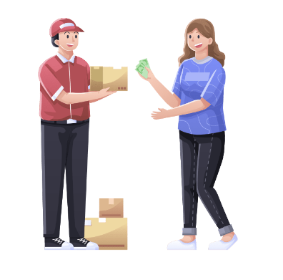
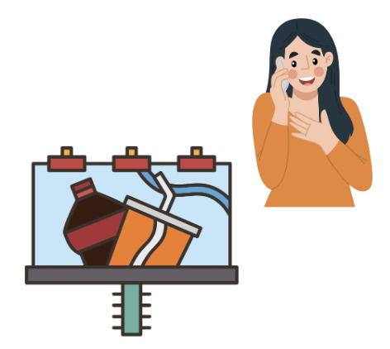
WHO?
Your customers
Who is it for?
Who are your customers?
How to reach your customers? How will you deliver your product?
How will you help your customers?
How will you interact with them?
Describe your customers, their needs and desires.
Show the channels you will use to reach your customers.
Describe how your product or service will help your customers.

Slide 10
WHO?
Your customers

Slide 11
HOW?

Slide 12
HOW?
Who and what do you need?
In this part of the Pitch you should explain the strategic alliances, key activities and key resources of your business idea.
Strategic Alliances refers to “Who can help you”. They are like teaming up with other companies or people to make your business stronger.
It's like when two companies join forces to create something amazing together. They might share their ideas, resources, or even work together on projects. By forming strategic alliances, businesses can do more and be more successful by combining their strengths.
Key Activities refer to “How will you do ti?”. They are the important tasks or actions that a company needs to do in order to be successful.
For example, if you're running a toy store, some of your key activities might be buying new toys to sell, organizing the store, and making sure everything is clean and tidy. These activities are crucial for the smooth running of the business and achieving its goals.
Key Resources refer to “What do you need?”. They are the things a company needs to have in order to operate and be successful.
Key resources can be different for each business. It can include things like tools, equipment, materials, or even people with special skills. For example, if you're running a bakery, your key resources would be things like ovens, baking ingredients, and talented bakers.
Having the right key resources is important because they help a business do its key activities effectively and achieve its goals.

Slide 13
HOW?
Who and what do you need?
Who are your key partners?
What will you do to make your business successful?
What resources will you need?
Describe who will help you make your business work.
Show what key activities you will need to perform.
Describe the key resources you will need to make your business work.

Slide 14
HOW?
Who and what do you need?

Slide 15
HOW MUCH?

Slide 16
HOW MUCH?
Costs and Revenues
In this part of the pitch you should explain the costs you will have to incur in order to offer your product or service as well as the benefits you expect to obtain.
The cost structure refers to the expenses that a business incurs in order to operate and generate revenue. Understanding the cost structure is important for businesses as it helps them to identify areas where they can reduce costs and increase profitability. The cost structure can be divided into two main categories: fixed costs and variable costs.
FIXED costs: these are costs that do not change regardless of the volume of goods or services produced. Examples of fixed costs include rent, salaries, insurance, and equipment maintenance. These costs are usually incurred on a regular basis, and businesses must pay them regardless of whether or not they are generating revenue;
VARIABLE costs: these are costs that vary depending on the volume of goods or services produced. Examples of variable costs include raw materials, production costs, and sales commissions. These costs increase or decrease in direct proportion to the level of production or sales.

Slide 17
HOW MUCH?
Costs and Revenues
Cost structure
Revenue sources
How much does it cost to make your product or provide your service?
What are the fixed and variable costs?
How do you plan to finance your business?
How do you plan to make money?
What is your revenue model based on?
How much money do you plan to earn?

Slide 18
HOW MUCH?
Costs and Revenues

Slide 19
THE TEAM
Name
Name
Name
Name
Rol in the project
Rol in the project
Rol in the project
Rol in the project
Experience and strenghts
Experience and strenghts
Experience and strenghts
Experience and strenghts

Slide 20
Rubric for evaluating student’s pitches
Criteria
Score
Clear and well-structured presentation
Quality of the information presented
Ability to answer questions after the presenttion
Originality and creativity

Slide 21
Tips to make an excellent presentation
To make an excellent presentation, remember these 4 things:
1. Know your idea/business and your presentation well.
2. Try to explain key ideas well
3. Use relevant and attractive images and graphics
4. Show enthusiasm and passion!!

